Slide 1


Gene Henry Gueco
Sep. 24, 2023

Slide 2
Outline
Executive Summary
Introduction
Methodology
Results
Conclusion
Appendix

Slide 3
Executive Summary
Summary of methodologies
Data Collection through API and Web Scraping
Data Wrangling
Exploratory Analysis with SQL and Data Visualization
Interactive Visual Analytics
Machine Learning
Summary of all results
Exploratory results
Screenshots for Interactive Visual Analytics
Prediction results from Machine Learning

Slide 4
Introduction
Project background and context
Space X advertises Falcon 9 rocket launches on its website with a cost of 62 million dollars; other providers cost upward of 165 million dollars each, much of the savings is because Space X can reuse the first stage. Therefore, if we can determine if the first stage will land, we can determine the cost of a launch. This information can be used if an alternate company wants to bid against space X for a rocket launch. This goal of the project is to create a machine learning pipeline to predict if the first stage will land successfully.
Problems you want to find answers
Factors to determine if the rocket will land successfully.
Landing Success Rates
Proper predictions for conditions to maximize the success rates of landing outcomes.

Slide 5

Section 1

Slide 6
Methodology
Executive Summary
Data collection methodology:
SpaceX API and web scraping.
Perform data wrangling
Exploratory data analysis and determining training labels
Perform exploratory data analysis (EDA) using visualization and SQL
Perform interactive visual analytics using Folium and Plotly Dash
Perform predictive analysis using classification models
How to build, tune, evaluate classification models

Slide 7
Data Collection
Data collection methods:
Using get request to the SpaceX API.
Decoding the response as Json using .json() function call and turn it into a pandas dataframe using .json_normalize().
Data Cleaning with identifying missing values and populating them if necessary.
Web scraping using BeautifulSoup.
Extract records as HTML and parse it to Pandas dataframe.

Slide 8
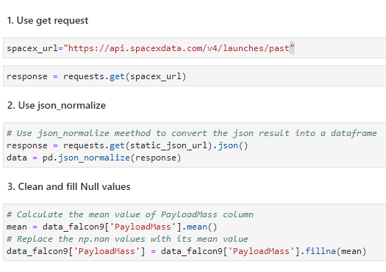
Data Collection – SpaceX API
Using the get request to the SpaceX API to collect data, clean and did some basic data wrangling and formatting.
Github URL:
https://github.com/GeneGueco/DS-Coursera-Capstone/blob/main/Data%20Collection%20API.ipynb

Slide 9
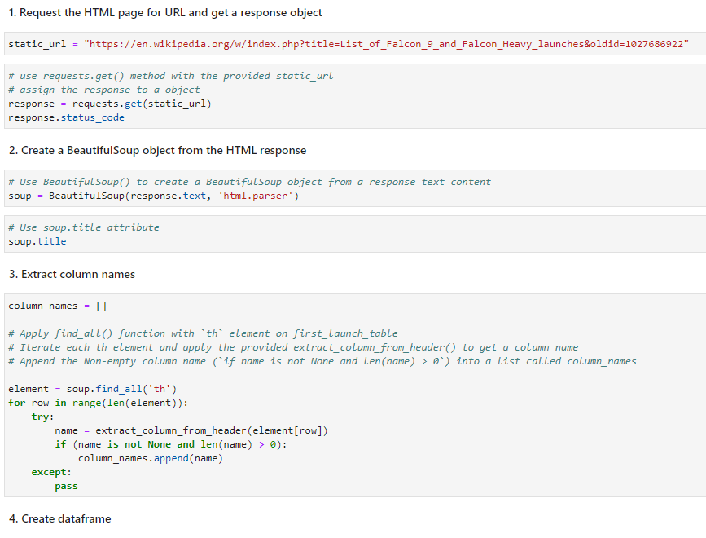
Data Collection - Scraping
Web scraping Falcon 9 launches with BeautifulSoup and parsed it convert to pandas dataframe.
Github URL:
https://github.com/GeneGueco/DS-Coursera-Capstone/blob/main/Data%20Collection%20with%20Web%20Scraping.ipynb

Slide 10

Data Wrangling
Performed exploratory Data Analysis and determined Training Labels.
Calculated the number of launches on each site.
Calculated the number and occurrence of each orbit.
Calculate the number and occurrence of mission outcome per orbit type.
Created a landing outcome label
Github URL:
https://github.com/GeneGueco/DS-Coursera-Capstone/blob/main/Data%20Wrangling.ipynb

Slide 11
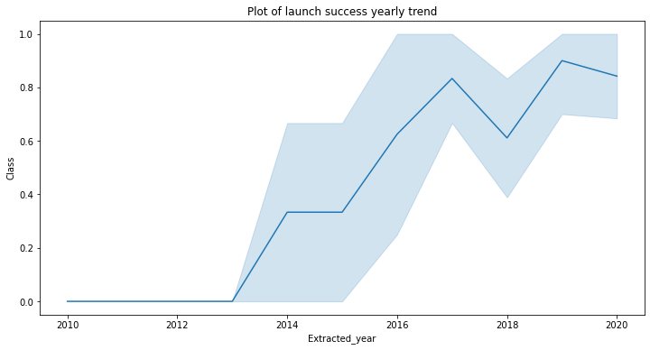
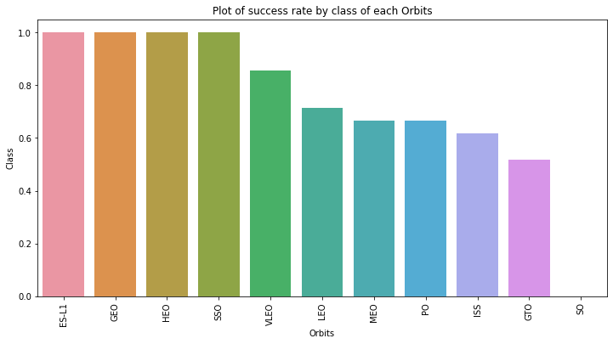
EDA with Data Visualization
We explored the data by visualizing the relationship between flight number and launch Site, payload and launch site, success rate of each orbit type, flight number and orbit type, the launch success yearly trend.
Github URL:
https://github.com/GeneGueco/DS-Coursera-Capstone/blob/main/EDA%20with%20Data%20Visualization.ipynb

Slide 12
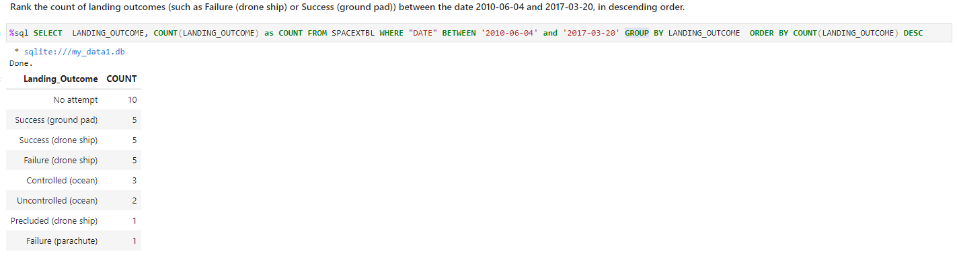
EDA with SQL
We loaded the SpaceX dataset into a PostgreSQL database without leaving the jupyter notebook.
We applied EDA with SQL to get insight from the data. We wrote queries to find out for instance:
Unique launch sites in the space mission
Total payload mass carried by boosters launched by NASA (CRS)
Average payload mass carried by booster version F9 v1.1
The total number of successful and failure mission outcomes
The failed landing outcomes in drone ship, their booster version and launch site names.
Rank the landing outcomes:
Github URL:
https://github.com/GeneGueco/DS-Coursera-Capstone/blob/main/EDA%20with%20SQL%20lab.ipynb

Slide 13
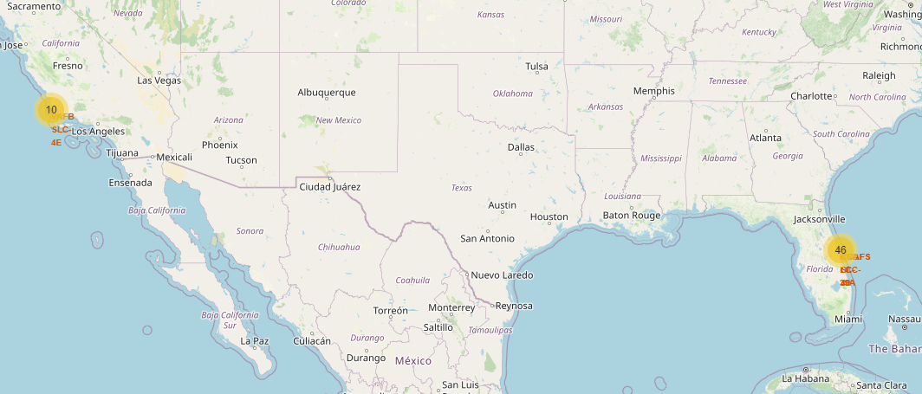
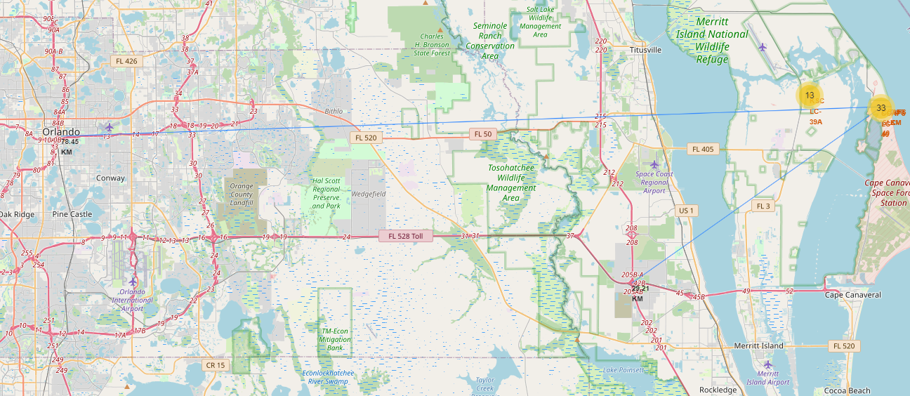
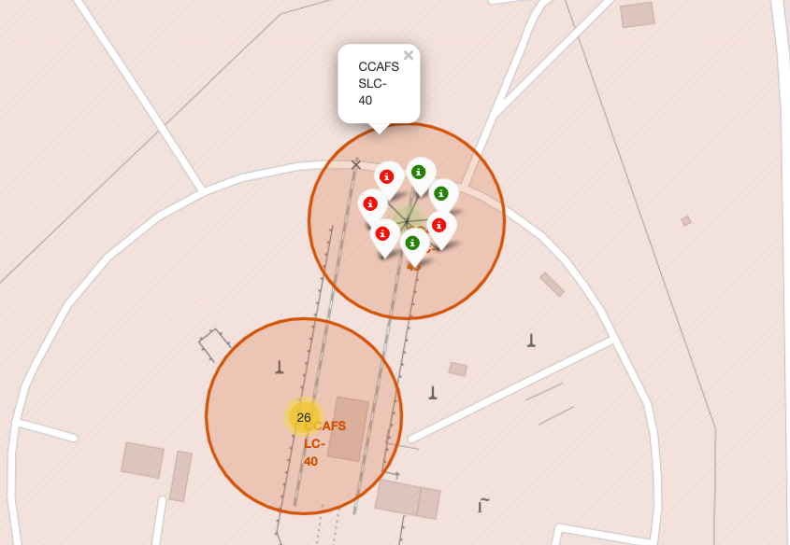
Build an Interactive Map with Folium
Marked all launch sites, and added map objects such as markers, circles, lines to mark the success or failure of launches for each site on the folium map.
Assigned the feature launch outcomes (failure or success) to class 0 and 1.i.e., 0 for failure, and 1 for success.
Using the color-labeled marker clusters, we identified which launch sites have relatively high success rate.
Calculated the distances between a launch site to its proximities. We answered some question for instance:
Are launch sites near railways, highways and coastlines.
Do launch sites keep certain distance away from cities.
Github URL: https://github.com/GeneGueco/DS-Coursera-Capstone/blob/main/Interactive%20Visual%20Analytics%20with%20Folium.ipynb

Slide 14
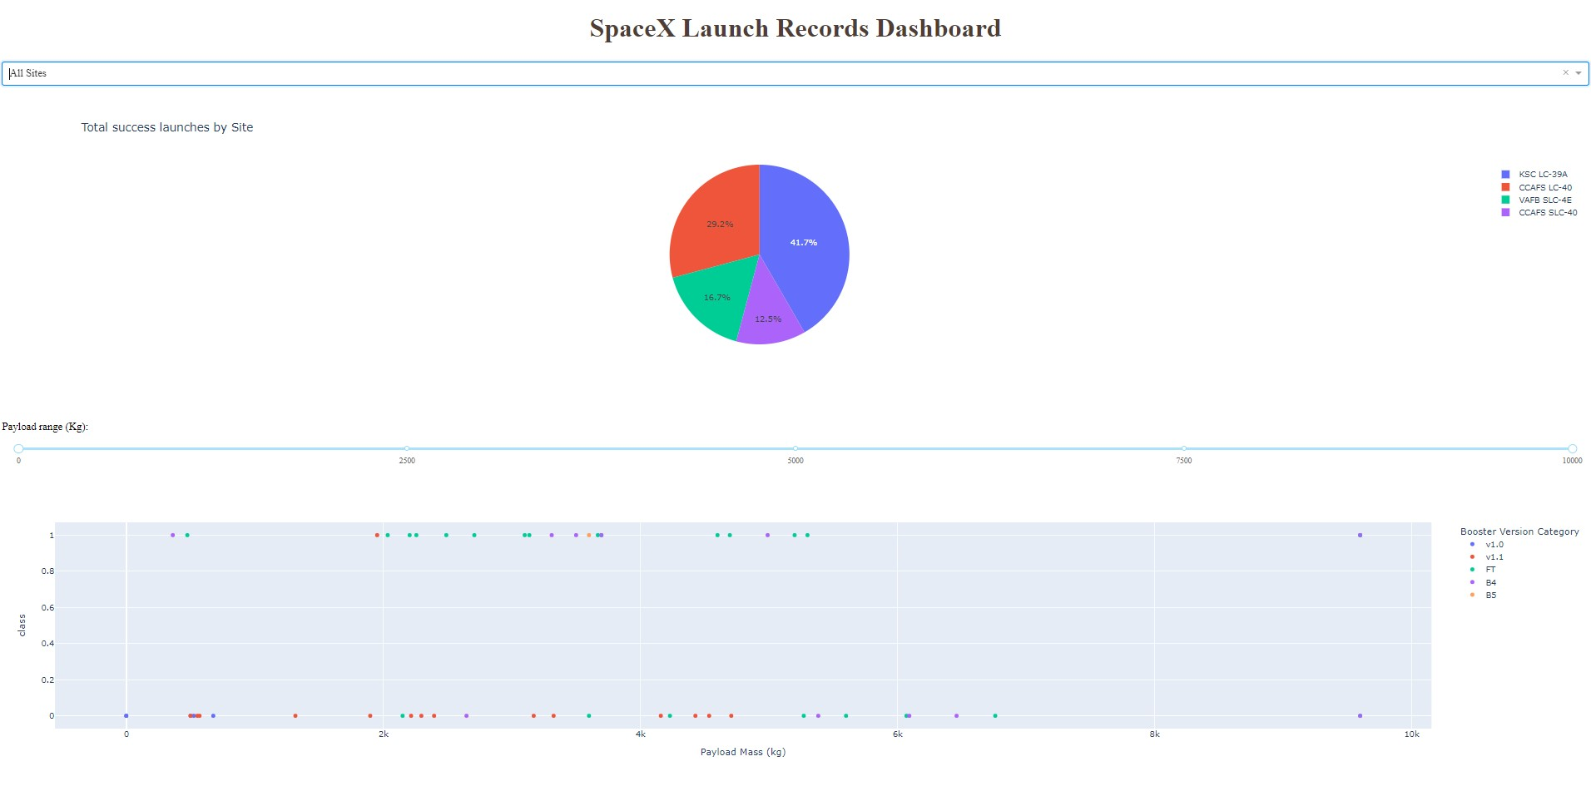
Build a Dashboard with Plotly Dash
Built an interactive dashboard with Plotly dash
Plotted pie charts showing the total launches by a certain sites
Plotted scatter graph showing the relationship with Outcome and Payload Mass (Kg) for the different booster version.
Github URL: https://github.com/GeneGueco/DS-Coursera-Capstone/blob/main/spacex_dash_app_gene.py

Slide 15
Predictive Analysis (Classification)
Loaded the data using numpy and pandas, transformed the data, split our data into training and testing.
Built different machine learning models and tune different hyperparameters using GridSearchCV.
Used accuracy as the metric for our model, improved the model using feature engineering and algorithm tuning.
Found the best performing classification model.
Github URL:
https://github.com/GeneGueco/DS-Coursera-Capstone/blob/main/Machine%20Learning%20Prediction.ipynb

Slide 16
Results
Exploratory data analysis results
Interactive analytics demo in screenshots
Predictive analysis results

Slide 17

Section 2

Slide 18
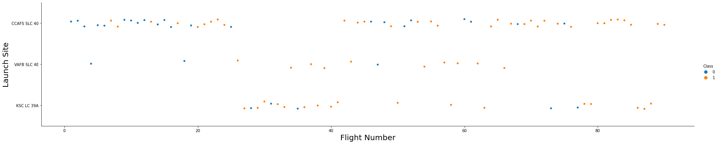
Flight Number vs. Launch Site
From the plot, we found that the larger the flight amount at a launch site, the greater the success rate at a launch site.

Slide 19
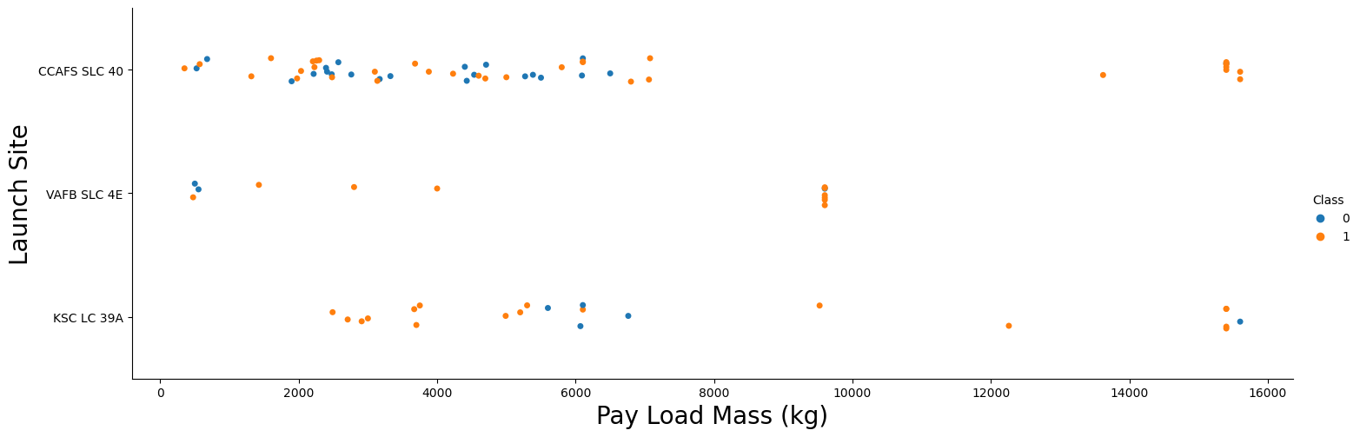
Payload vs. Launch Site
If you observe Payload Vs. Launch Site scatter point chart you will find for the VAFB-SLC launch site there are no rockets launched for heavy payload mass(greater than 10000)

Slide 20
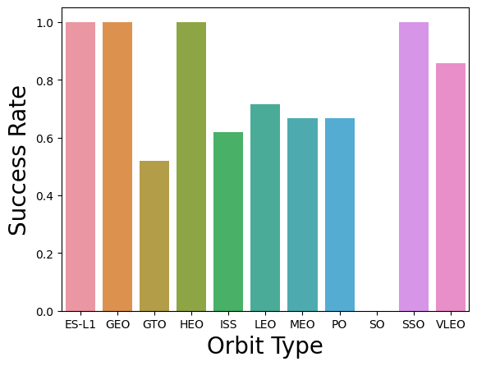
Success Rate vs. Orbit Type
From the plot, we can see that ES-L1, GEO, HEO, SSO had the most success rate.

Slide 21
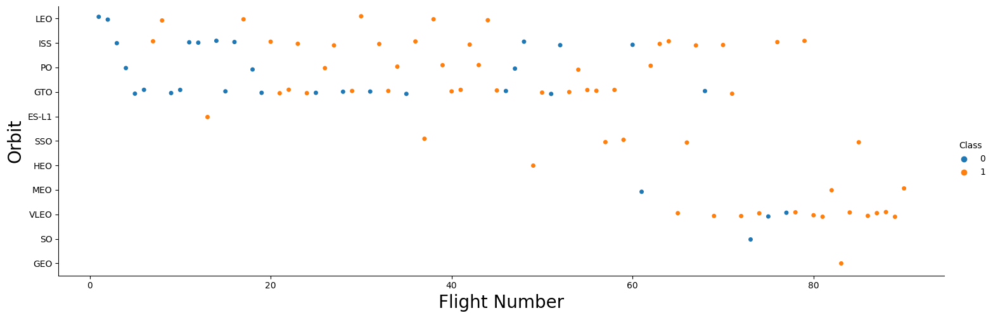
Flight Number vs. Orbit Type
You should see that in the LEO orbit the Success appears related to the number of flights; on the other hand, there seems to be no relationship between flight number when in GTO orbit.

Slide 22
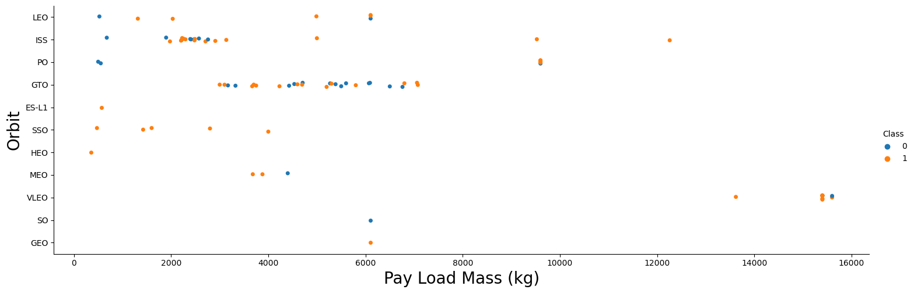
Payload vs. Orbit Type
With heavy payloads the successful landing or positive landing rate are more for Polar, LEO and ISSs

Slide 23
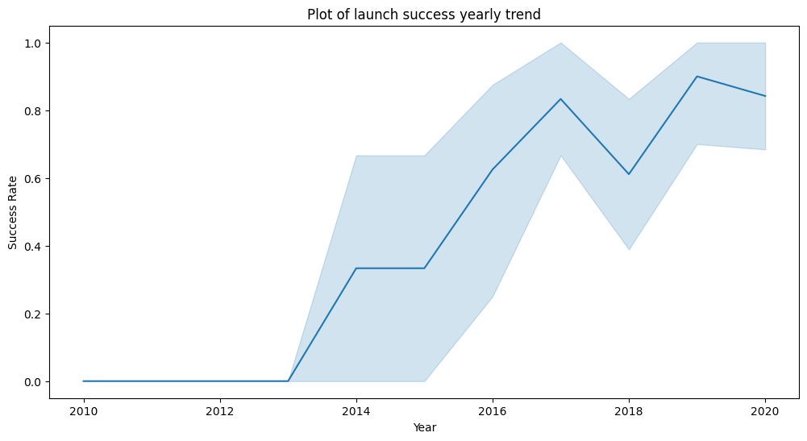
Launch Success Yearly Trend
From the plot, we can see that the success rate since 2013 kept on increasing until 2020

Slide 24
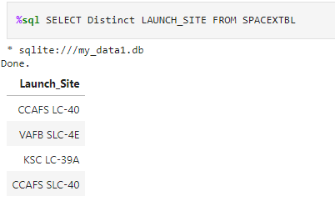
All Launch Site Names
Unique launch site names:
CCAFS LC-40
VAFB SLC-4E
KSC LC-39A
CCAFS SLC-40
Using Distinct, we can show unique names on the LAUNCH_SITE column.

Slide 25
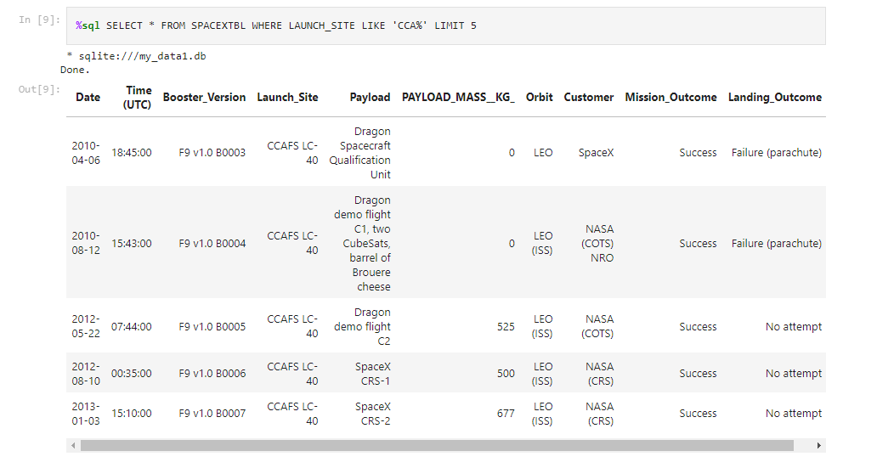
Launch Site Names Begin with 'CCA'
Using the Like operator in the where clause, we can eliminate entries that are not starting with CCA.
Also used Limit clause to get desired query output
e.g. LAUNCH_SITE LIKE ‘CCA%’

Slide 26
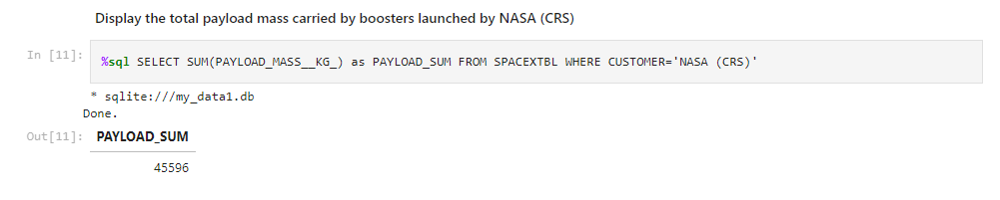
Total Payload Mass
Using SUM function, calculate the total payload carried by boosters from NASA as 45596 using the query below

Slide 27
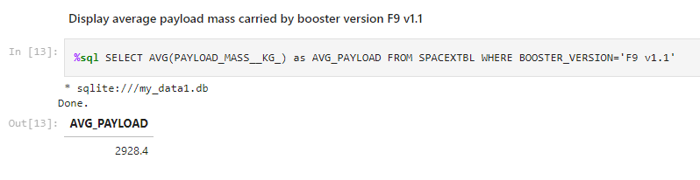
Average Payload Mass by F9 v1.1
Using AVG function, calculate the average payload mass carried by booster version F9 v1.1 as 2928.4

Slide 28
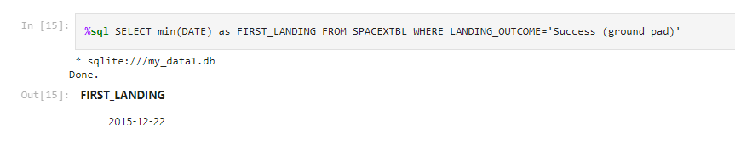
First Successful Ground Landing Date
We can observe that the exact date for the first successful landing outcome on ground pad was achieved at the 22nd of December 2015.
Using the MIN function, we are able to output the first date in the column.

Slide 29
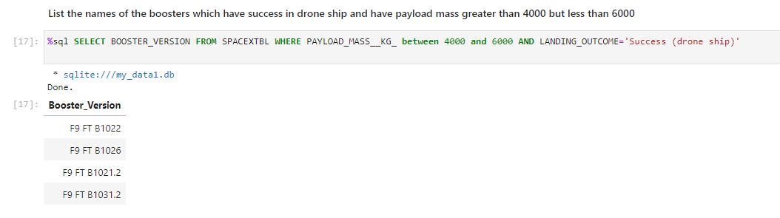
Successful Drone Ship Landing with Payload between 4000 and 6000
Used the WHERE clause to filter the boosters which have successfully landed on drone ship and applied the BETWEEN and AND operator to determine successful landing with payload mass greater than 4000 but less than 6000.

Slide 30
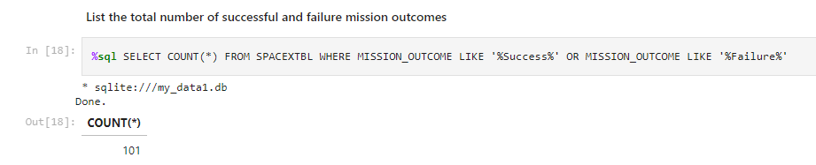
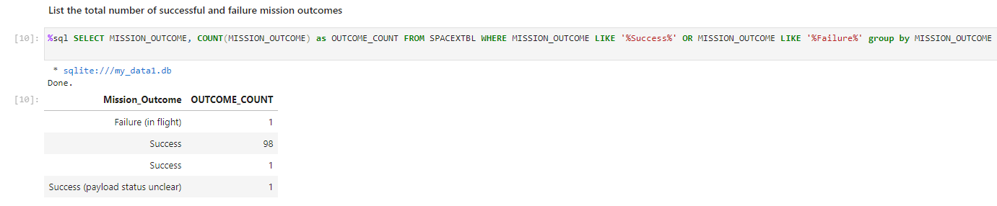
Total Number of Successful and Failure Mission Outcomes
Using the Like operator and Or operator in the Where clause to filter out the results while using the Count function to get the total of mission outcomes based on criteria.
We can also adjust the query to show each type of mission outcome and their count result

Slide 31
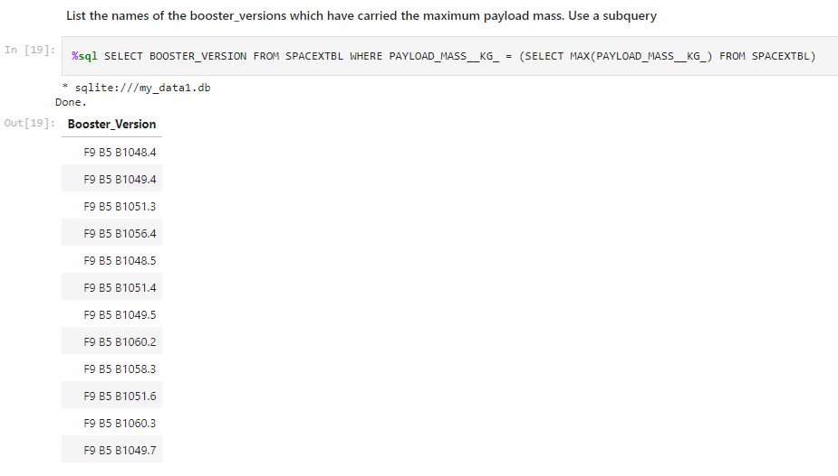
Boosters Carried Maximum Payload
We determined the booster that have carried the maximum payload using a subquery in the WHERE clause and the MAX function.

Slide 32
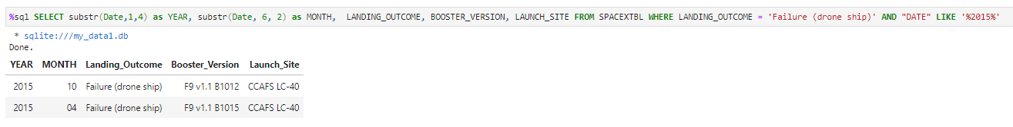
2015 Launch Records
By using SUBSTR function, we acquired the year and month from the DATE column.
Also filtered the Landing_Outcome by ‘Failure (drone ship)’ and used the Like operator for the desired year.

Slide 33
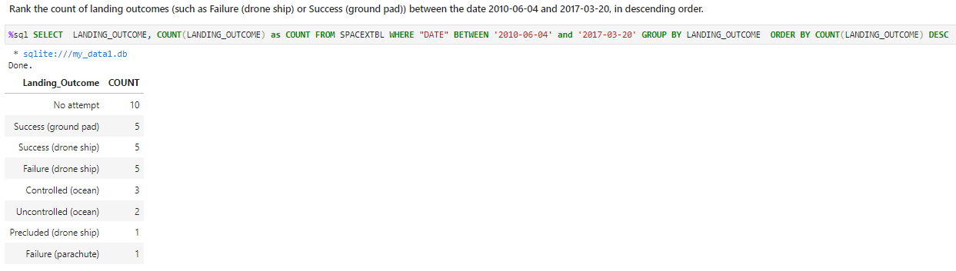
Rank Landing Outcomes Between 2010-06-04 and 2017-03-20
Used Count function to get the total of landing outcomes.
Used Between since we are trying to find results in a date range.
Used Group By to get same results per category and Order By to rank by descending order

Slide 34

Section 3

Slide 35
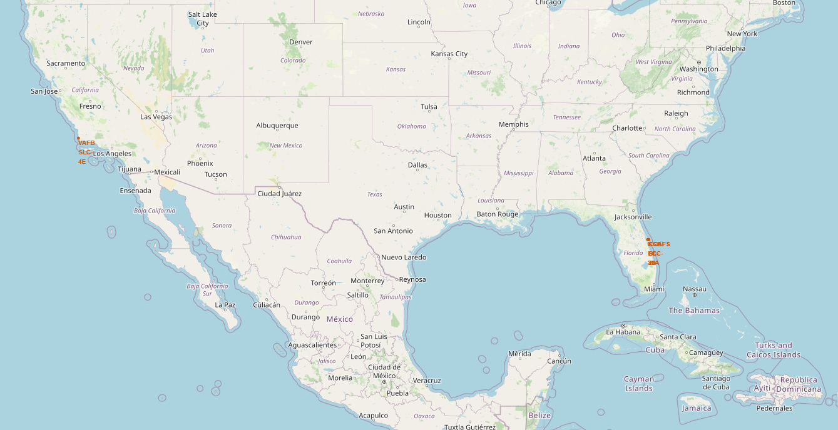
Marking all launch sites on a map
As observed from the map, the SpaceX launch sites are in the United States of America and are near the coast line.

Slide 36
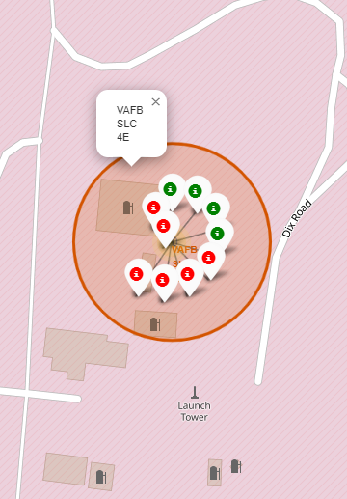
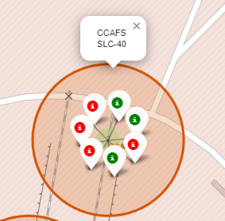
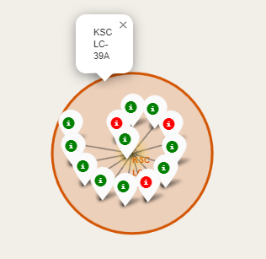
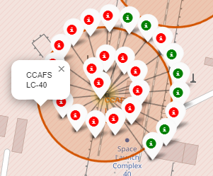
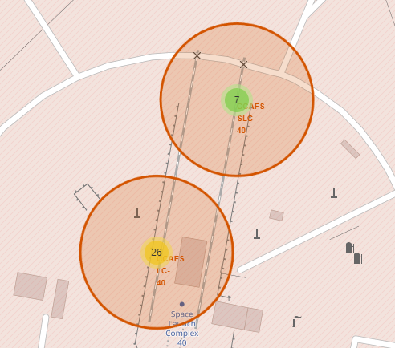
Colored Markers showing Launch sites and Outcomes
Legend:
Green Marker – Success
Red Marker - Failure
California Launch Sites
Florida Launch Sites

Slide 37
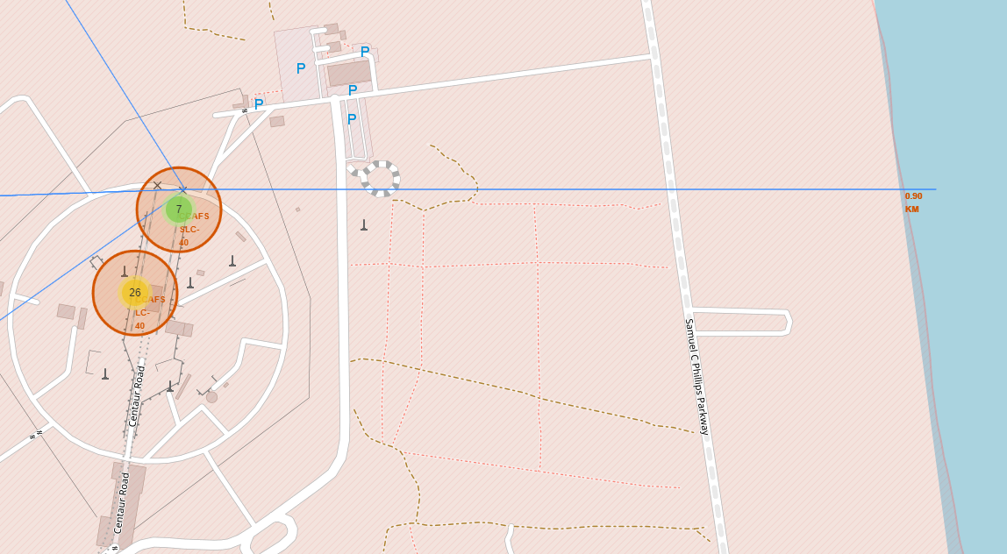
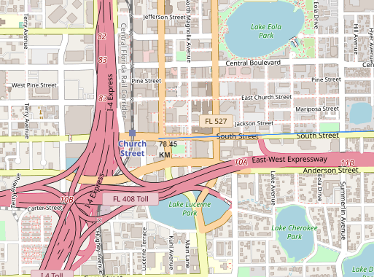
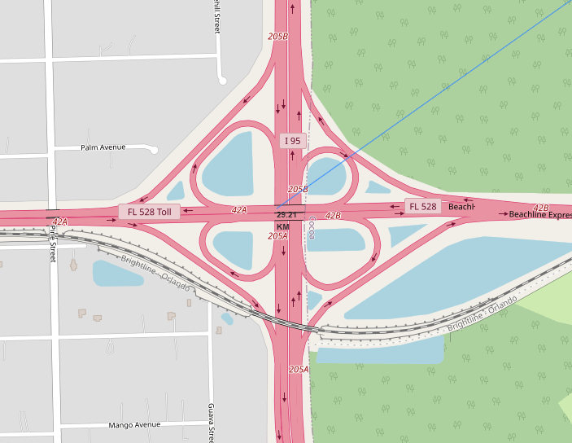
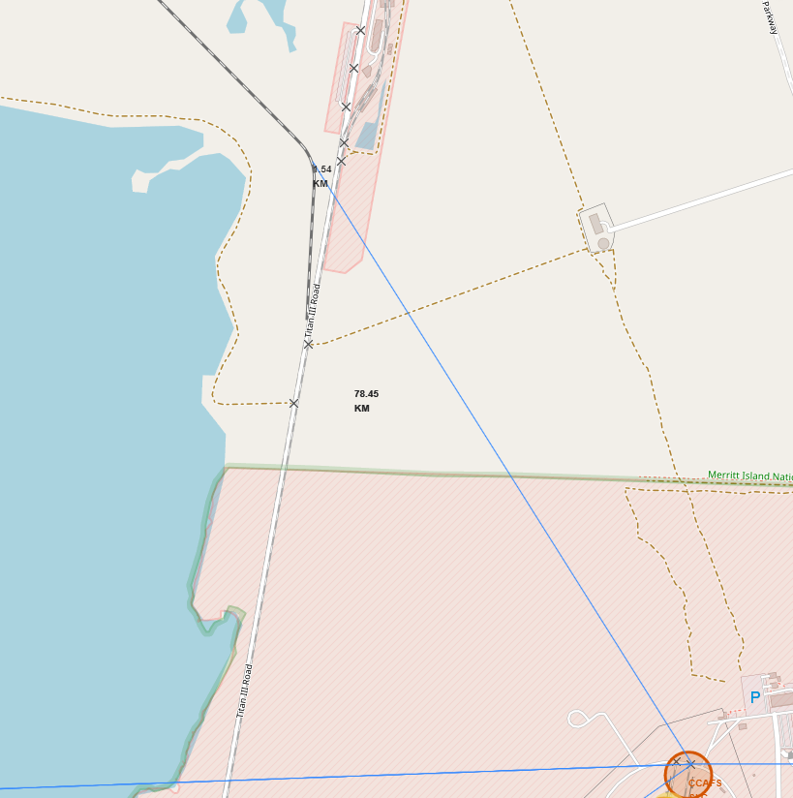
Distance to Landmarks
Distance to Coastline (0.9km)
Distance to City (78.45km)
Are launch sites in close proximity to landmarks?
Railways - Yes
Highways – No
Coastline – Yes
Cities - No
Distance to Highway (29.21km)
Distance to Railway (1.54km)

Slide 38

Section 4

Slide 39
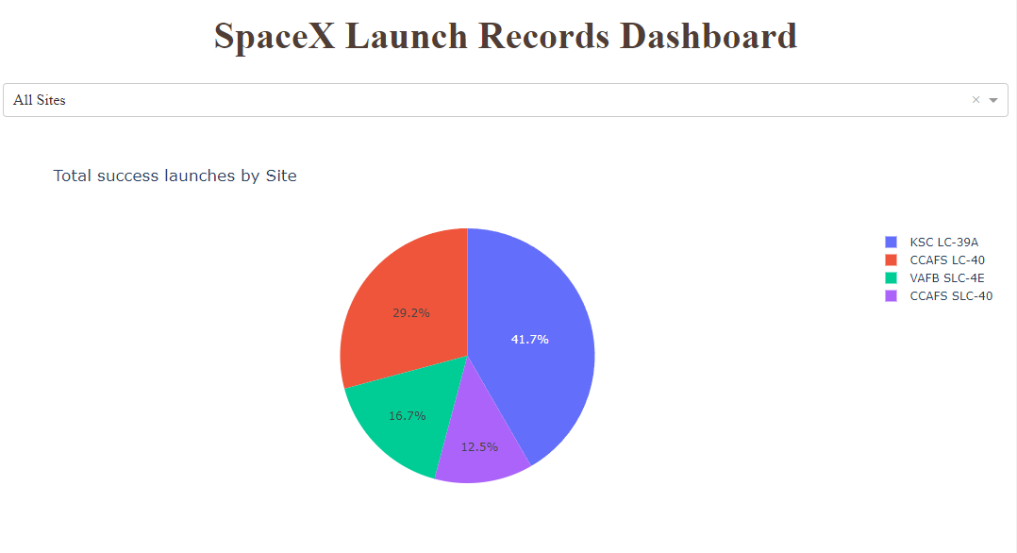
Pie chart success rates by each launch site
As seen on the dashboard, KSC LC-39A has the most successful launches from all the sites

Slide 40
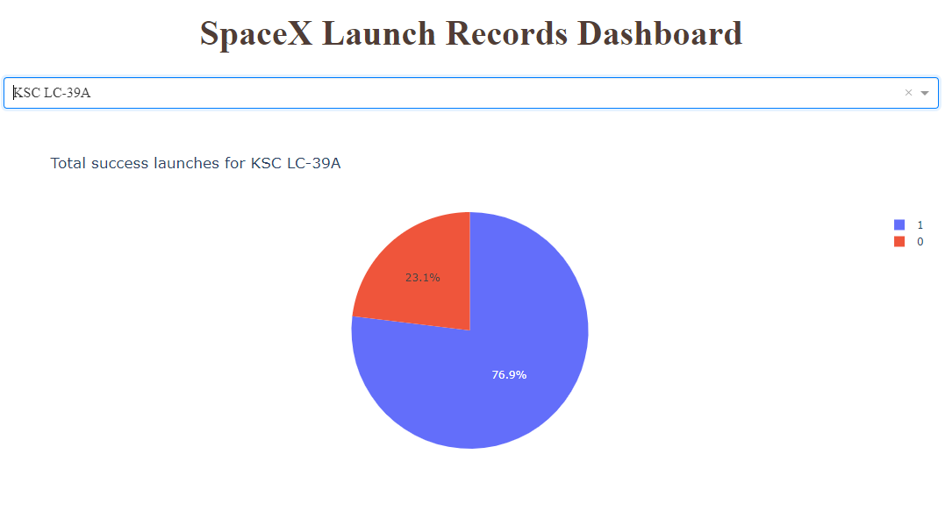
Pie chart showing the Launch site with the highest success ratio
KSC LC-39A achieved a 76.9% success rate while only having a 23.1% failure rate.

Slide 41
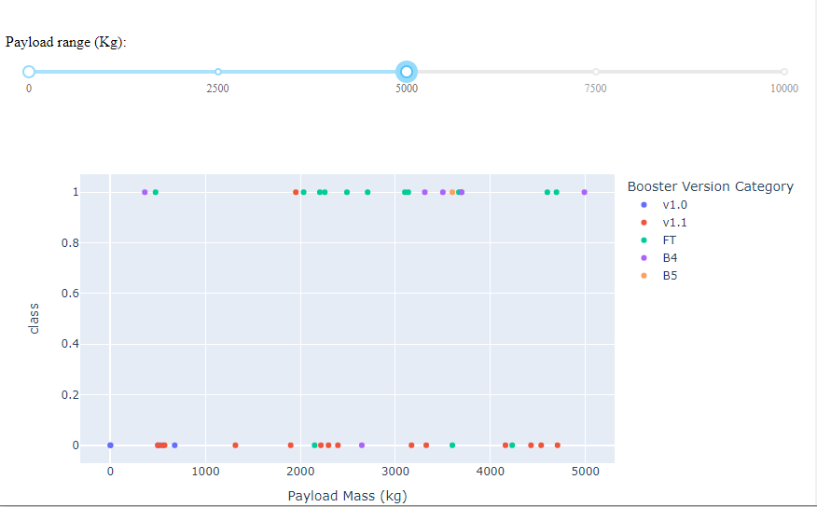
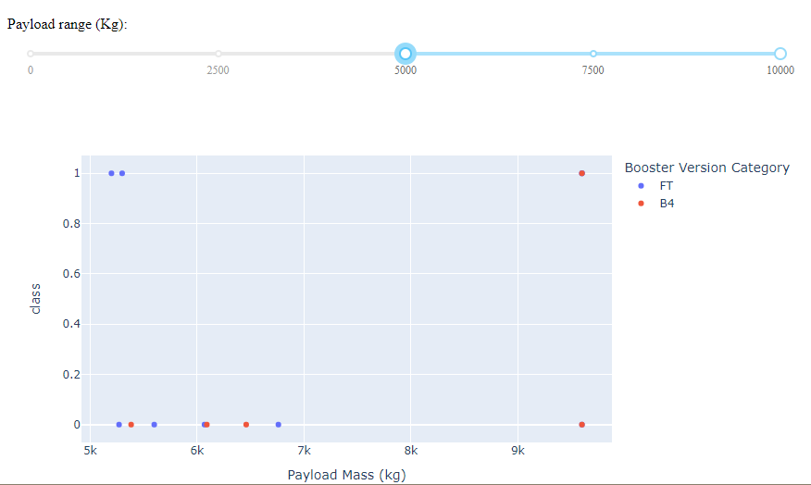
Payload vs Launch Outcome Scatter plot for all sites using different payload range
Low to Mid Payload 0kg – 5000kg
Mid to High Payload 5000kg – 10000kg
From the images above, we can see that the success rates for lower payloads is greater than in higher payloads

Slide 42

Section 5

Slide 43
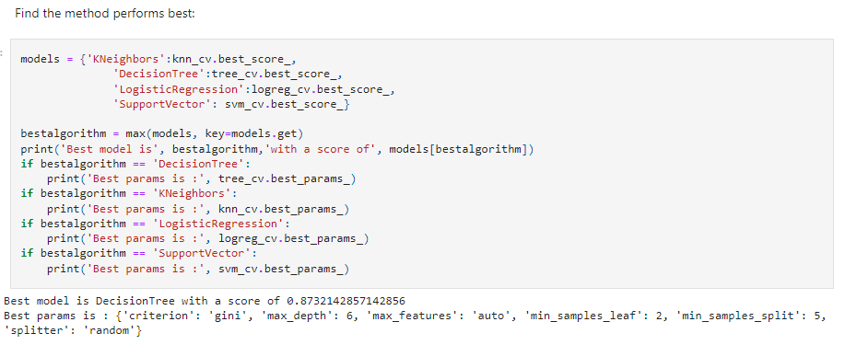
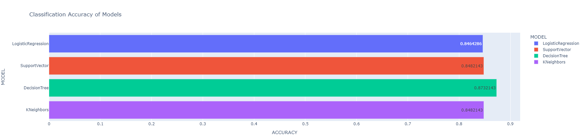
Classification Accuracy
The Decision Tree Model has the best accuracy with a score of 0.8732142857142856

Slide 44
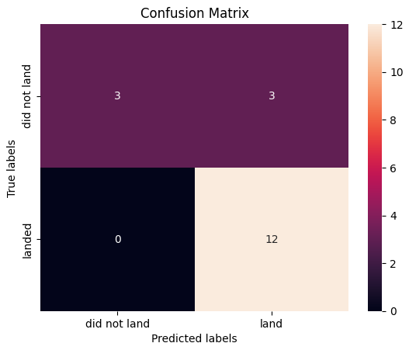
Confusion Matrix
The confusion matrix for the decision tree classifier shows that the classifier can distinguish between the different classes. The major problem is the false positives .i.e., unsuccessful landing marked as successful landing by the classifier.

Slide 45
Conclusions
Launch success rates started to increase in 2013 up to 2020
The larger the flight amount at a launch site, the higher the success rate it has.
Orbits ES-L1, GEO, HEO and SSO had the most success rate.
KSC LC-39A had the most successful launches of any sites.
The Decision Tree classifier is the best machine learning algorithm for this task.

Slide 46
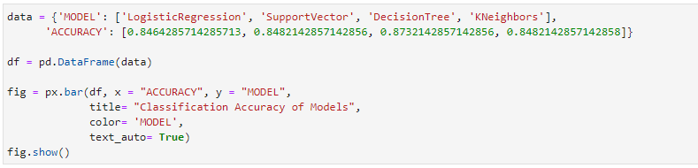
Appendix
Here is the code for creating the simple bar chart for classification’s model accuracy

Slide 47


